Slide 1
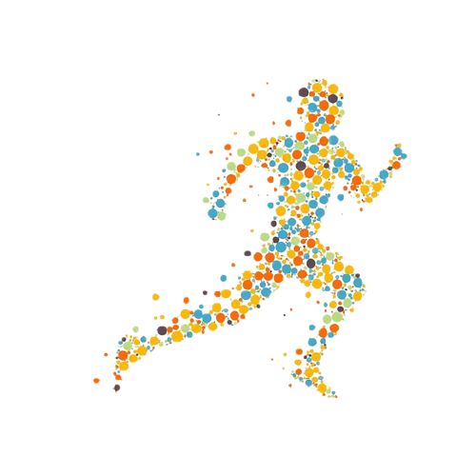
HUMAN ACTIVITY RECOGNITION USING LSTMs
TEAM MEMBERS :
ANANT VAID – PES2201800712
R HARISH – PES2201800541
RICHA ANGADI – PES2201800111
SHASHANK S BYAKOD – PES2201800412

Slide 2
INTRODUCTION
Human activity recognition, or HAR for short, is a broad field of study concerned with identifying the specific movement or action of a person based on sensor data.
Movements are often typical activities performed indoors, such as walking, talking, standing, and sitting. They may also be more focused activities such as those types of activities performed in a kitchen or on a factory floor.
The sensor data may be remotely recorded, such as video, radar, or other wireless methods.

Slide 3
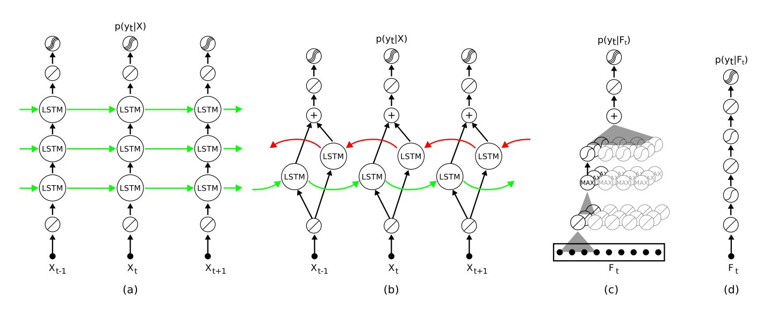
ARCHITECTURE
(a) LSTM network hidden layers containing LSTM cells and a final softmax layer at the top. (b) bi-directional LSTM network with two parallel tracks in both future direction (green) and to the past (red). (c) Convolutional networks that contain layers of convolutions and max-pooling, followed by fully-connected layers and a softmax group. (d) Fully connected feed-forward network with hidden (ReLU) layers.

Slide 4
DATASET
We used the Human Activity Recognition Using Smartphones Data Set as found on UCI Machine Learning Repository.
Human Activity Recognition database is built from the recordings of 30 subjects performing activities of daily living (ADL) while carrying a waist-mounted smartphone with embedded inertial sensors.
The experiments have been carried out with a group of 30 volunteers within an age bracket of 19-48 years.
Each person performed six activities (WALKING, WALKING_UPSTAIRS, WALKING_DOWNSTAIRS, SITTING, STANDING, LAYING) wearing a smartphone on the waist.
Using its embedded accelerometer and gyroscope, we captured 3-axial linear acceleration and 3-axial angular velocity at a constant rate of 50Hz.
The experiments have been video-recorded to label the data manually. The obtained dataset has been randomly partitioned into two sets, where 70% of the volunteers was selected for generating the training data and 30% the test data.

Slide 5
Contd..
For each record in the dataset it is provided:
Triaxial acceleration from the accelerometer (total acceleration) and the estimated body acceleration.
Triaxial Angular velocity from the gyroscope.
A 561-feature vector with time and frequency domain variables.
Its activity label.
An identifier of the subject who carried out the experiment.

Slide 6
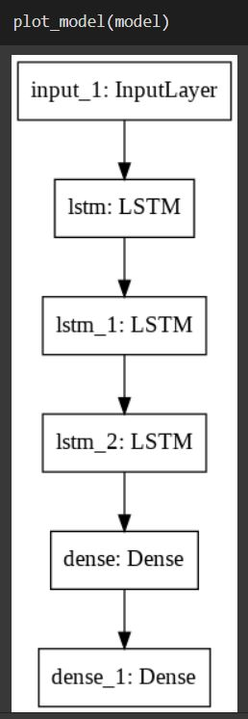
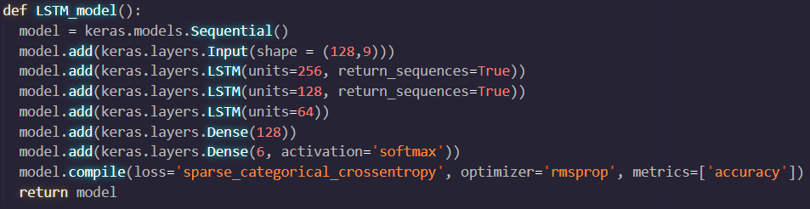
LSTM Model
This the model that we used.
Three stacked LSTM layer to extract the features

Slide 7
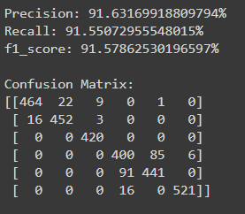
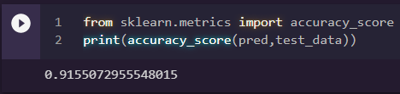
Performance Metrics

Slide 8
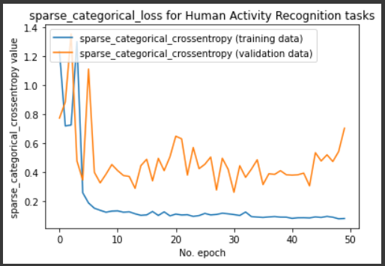
Training Loss v/s Validation Loss

Slide 9
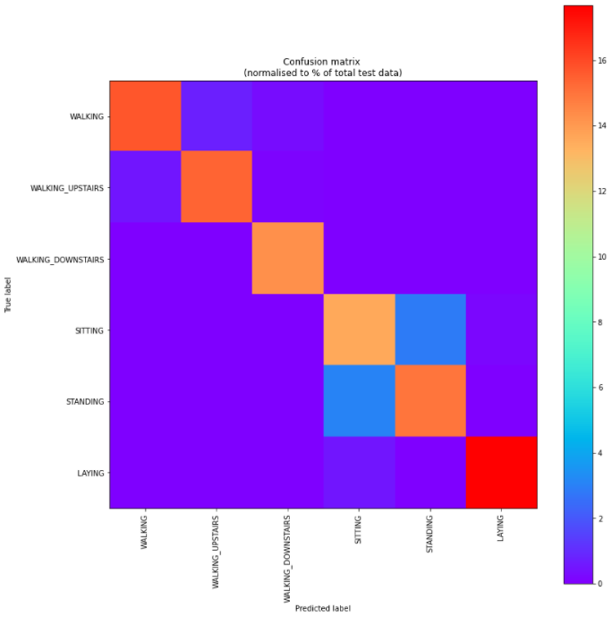
Confusion Matrix

Slide 10
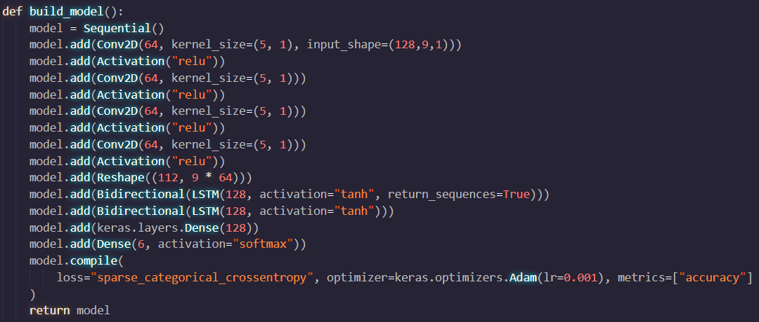
BiLSTM model with Convolutional Layer

Slide 11
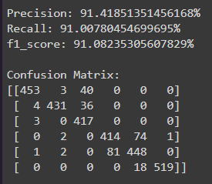
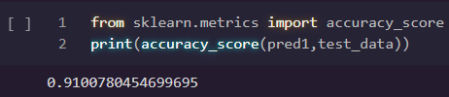
Performance Metrics

Slide 12
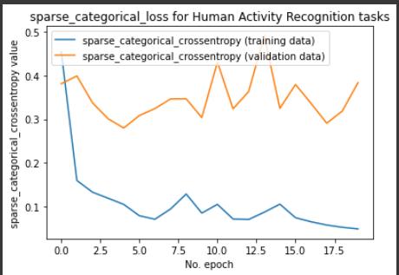
Training Loss v/s Validation Loss

Slide 13
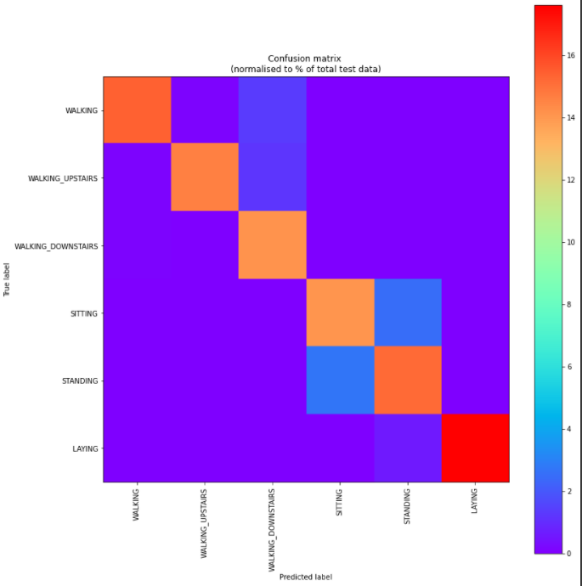
Confusion Matrix

Slide 14
Thank You

